Slide 1
Wireless Smart Socket Device
Product Owner: Abdullah Zafar
Scrum Master: Mustafa Touqir
Developer: Syed Muhammad Saim

Slide 2
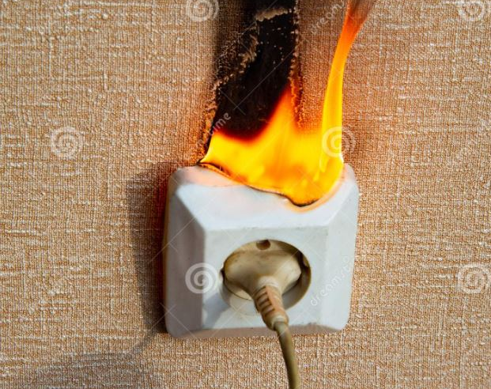
Motivation
Sockets burn
Old Outlets
Overloaded Circuits
Damage or improper wiring

Slide 3
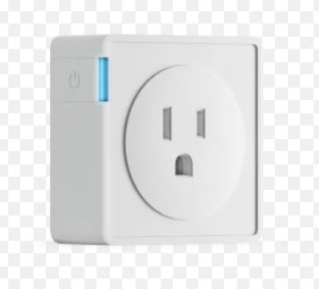
Solution : Smart Sockets
Smart Socket
Wifi network
Controlled via Smartphone

Slide 4
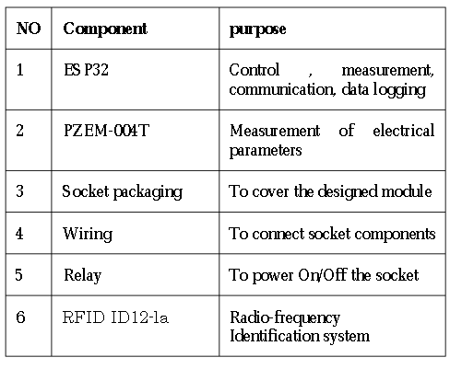
Components

Slide 5
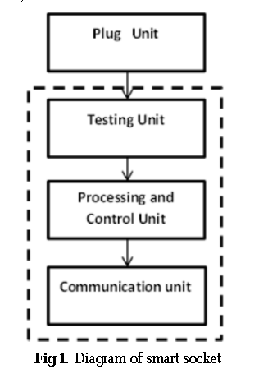
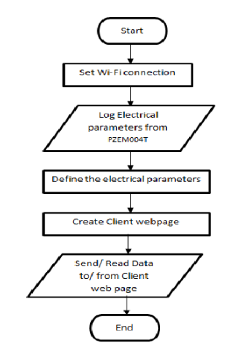
UML/SysML Diagrams

Slide 6
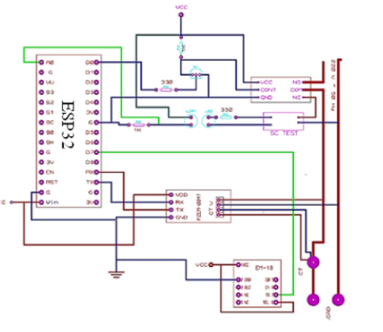
State of Art

Slide 7
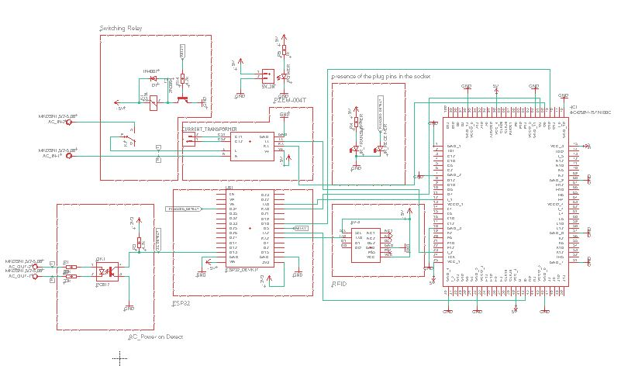
Schematic

Slide 8
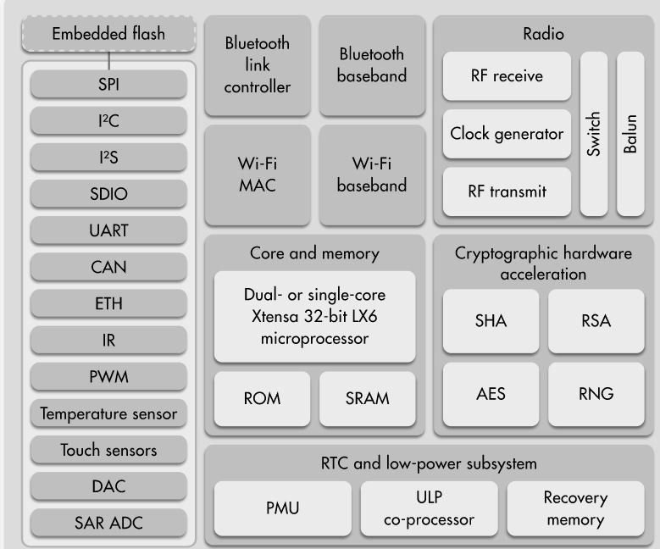
ESP32

Slide 9
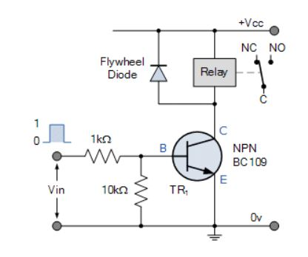
Switch relay

Slide 10
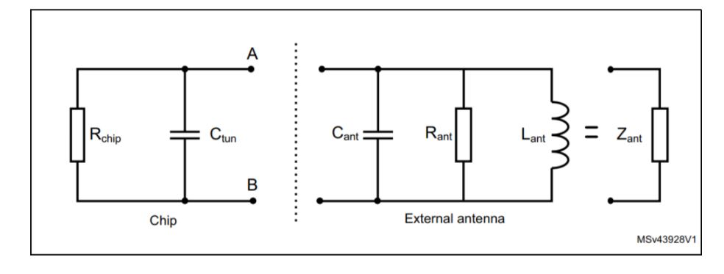
RFID

Slide 11
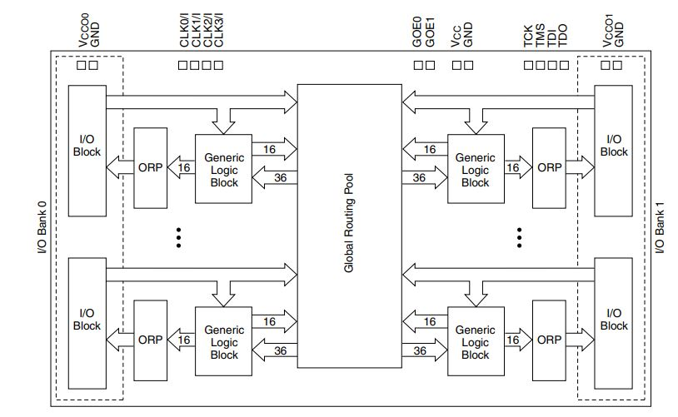
CPLD

Slide 12
Conclusion

Slide 13
Bibliography
https://www.researchgate.net/publication/332014410_New_Design_of_Socket_Modules_for_Smart_Home_Applications
Tiago M. Fernández-Caramés , An Intelligent Power Outlet System for the Smart Home of the Internet of Things, International Journal of Distributed Sensor Networks 2015(1):1-11 · November 2015
https://www.snapeda.com/parts/ESP32-DEVKITC-32D/Espressif%20Systems/view-part/

Slide 14

Thank You For Your Precious Time

